Slide 1
第7章 WPF入门

Slide 2
WPF介绍
WPF(Windows Presentation Foundation)是微软新一代的基于DirectX和GPU加速来实现的显示系统，用于生成能带给用户震撼视觉体验的 Windows 客户端应用程序。
WPF 的核心是一个与分辨率无关、基于矢量的呈现引擎，WPF使用XAML来描述界面。
WPF程序仍然从Main方法开始执行
App.xmal.cs文件
App.xmal中StartupUri属性指定显示的起始窗体
演示如何创建WPF程序

Slide 3
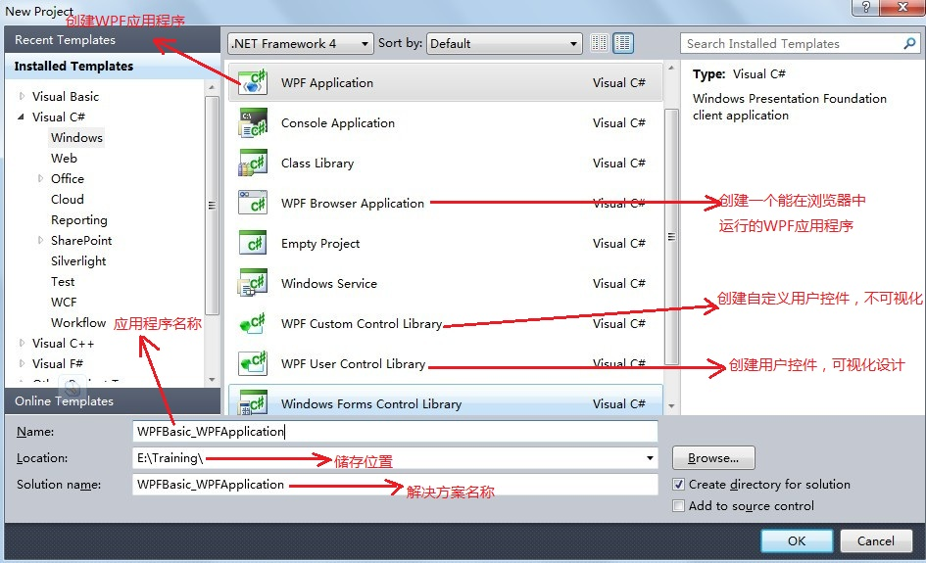
WPF应用程序

Slide 4
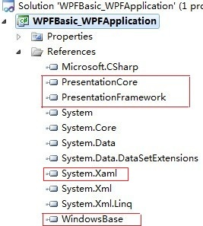
WPF应用程序
创建了一个WPF应用程序，模板中文件层次结构如图所示（在References里面自动引入了图中的PresentationCore、PresentationFramework、WindowsBase程序集）

Slide 5
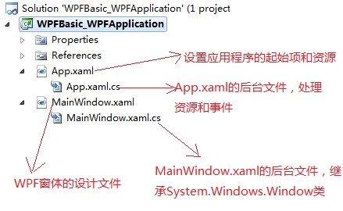
WPF应用程序

Slide 6
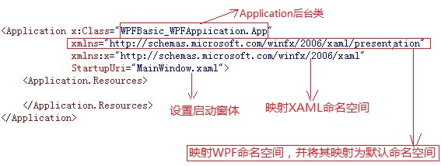
WPF应用程序

Slide 7
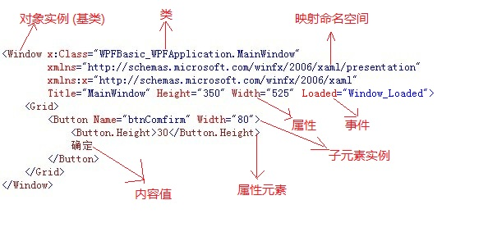
XAML结构

Slide 8
什么是XAML
XAML是一种基于XML的标记性语言。
对象元素：< … />
<Button>Click</Button>
<Button Name=“button1” Content=“Click”/>
注：Button button1 =new Button();
属性特性： “字符串” <Button Name=“button1” Content="Click"/>
注：Button button1 = new Button(); button1.Content = “Click”;

Slide 9
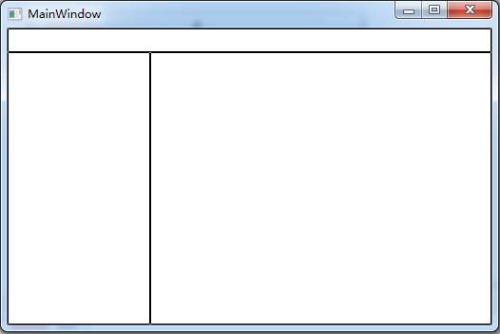
附加属性：使用其它对象元素的属性
<DockPanel>
<TextBox DockPanel.Dock="Top" Height="25" BorderBrush="Black"/>
<TextBox DockPanel.Dock="Left" Width="150" BorderBrush="Black"/>
<TextBox BorderBrush="Black"/>
</DockPanel>

Slide 10
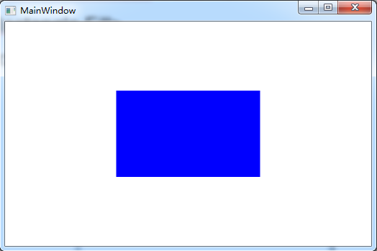
属性元素: 赋给属性的特性值为对象元素
<Rectangle Width="200" Height="120">
<Rectangle.Fill>
<SolidColorBrush Color="Blue"/>
</Rectangle.Fill>
</Rectangle>

Slide 11
将一个对象的属性值依赖在其它对象的某个属性上。
标记扩展：{ }
注：{ }中的类型需从 MarkupExtension 类派生。
public class CarClass
{
private string carName;
public string CarName
{
set { carName = value; }
get { return carName; }
}
}

Slide 12
<Window x:Class="WpfApplication1.MainWindow"
xmlns="http://schemas.microsoft.com/winfx/2006/xaml/presentation"
xmlns:x="http://schemas.microsoft.com/winfx/2006/xaml"
xmlns:d="http://schemas.microsoft.com/expression/blend/2008"
xmlns:mc="http://schemas.openxmlformats.org/markup-compatibility/2006"
xmlns:local="clr-namespace:WpfApplication1"
Title="MainWindow" Height="350" Width="525">
<Window.Resources>
<local:CarClass x:Key="CarObj" CarName="奔驰"/>
</Window.Resources>
<Grid>
<Button Width="100" Height="20" Content="{StaticResource ResourceKey=CarObj}"/>
</Grid>
</Window>
程序的演示效果是否正确？

Slide 13
public class CarClass
{
private string carName;
public string CarName
{
set { carName = value; }
get { return carName; }
}
public override string ToString()
{
return carName;
}
}

Slide 14
标记扩展：{ } //引用程序中的数据
注：{ }中的类型需从 MarkupExtension 类派生。
using System.Windows.Markup;
namespace CustomMarkupExtension
{
public class RandomExtension : MarkupExtension
{
readonly int _from, _to;
public RandomExtension(int from, int to)
{
_from = from;
_to = to;
}
public RandomExtension(int to) : this(0, to) { }
static readonly Random _rdn = new Random();
public override object ProvideValue(IServiceProvider serviceProvider)
{
return (double)_rdn.Next(_from, _to);
}
}
}

Slide 15
<Window x:Class="WpfApplication1.MainWindow"
xmlns="http://schemas.microsoft.com/winfx/2006/xaml/presentation"
xmlns:x="http://schemas.microsoft.com/winfx/2006/xaml"
xmlns:mext="clr-namespace:CustomMarkupExtension"
Title="MainWindow" Height="350" Width="600">
<StackPanel>
<TextBlock FontSize="{mext:RandomExtension 10,100}" Text="Hello World" x:Name="text1"/>
<TextBlock Text="{Binding ElementName=text1, Path=FontSize}"/>
</StackPanel>
</Window>

Slide 16
RouteEvent路由事件
<Grid Background="Green" MouseUp="MouseUp_1" Name="grid1">
<Grid Margin="50" Background="Red" MouseUp="MouseUp_1" Name="grid2">
<Grid Margin="50" Background="Blue" MouseUp="MouseUp_1" Name="grid3"/>
</Grid>
</Grid>
private void MouseUp_1(object sender, MouseButtonEventArgs e)
{
Grid g = sender as Grid;
MessageBox.Show(g.Name);
}

Slide 17
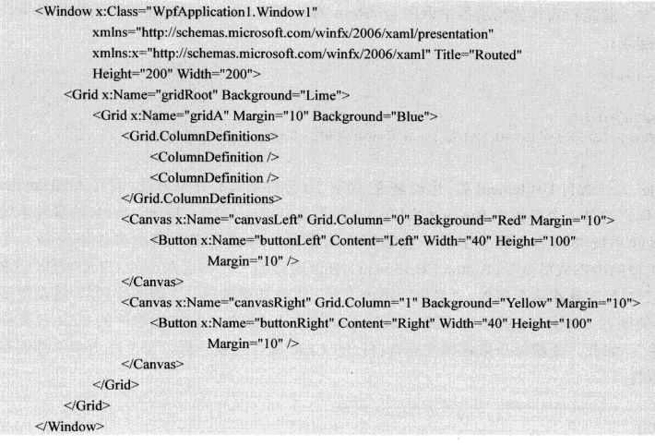
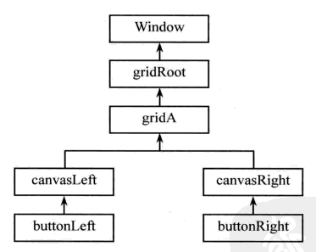

Slide 18
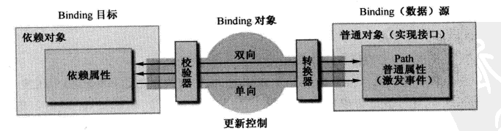
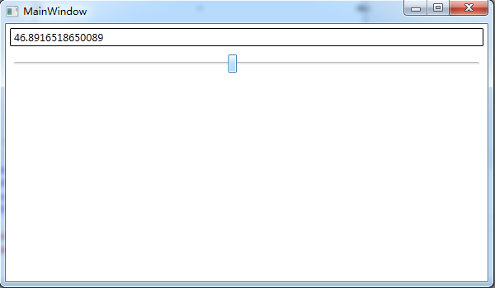
Binding绑定
<StackPanel>
<TextBox x:Name="textBox1" Text="{Binding Path=Value, ElementName=slider1}" BorderBrush="Black" Margin="5"/>
<Slider x:Name="slider1" Maximum="100" Minimum="0" Margin="5"/>
</StackPanel>

Slide 19
Mode属性
TwoWay
OneWay
OneWayToSource
Default
UpdateSourceTrigger属性
PropertyChanged
LostFocus
Default

Slide 20
没有Path的Binding
<StackPanel>
<StackPanel.Resources>
<sys:String x:Key="myString">
菩提本无物，明镜亦非台。
本来无一物，何处惹尘埃。
</sys:String>
</StackPanel.Resources>
<TextBlock TextWrapping="Wrap" Text="{Binding Path=., Source={StaticResource ResourceKey=myString}}" FontSize="16" Margin="5"/>
</StackPanel>

Slide 21
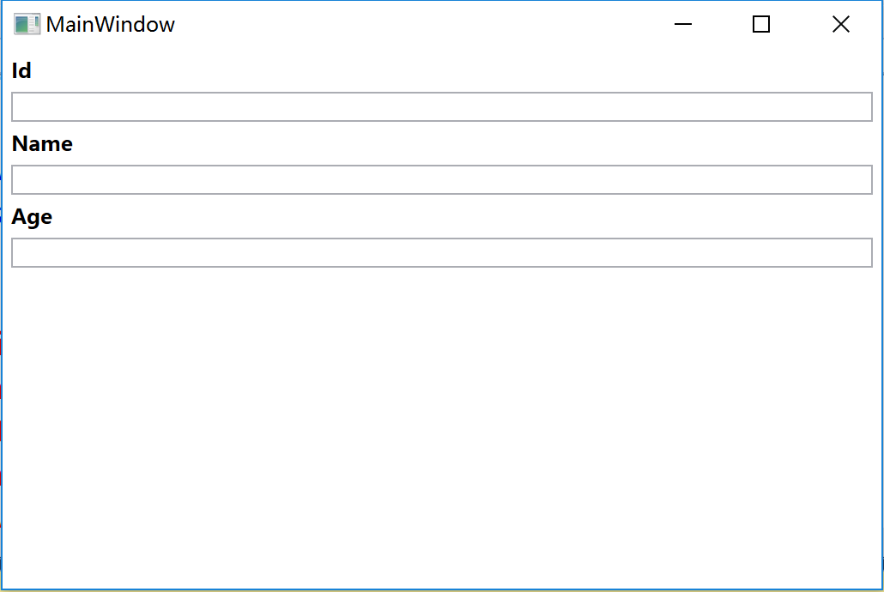
Binding程序中的变量
public class Student
{
private int id;
private string name;
private int age;
}

Slide 22
Binding程序中的数据
using System.ComponentModel;
public class Student : INotifyPropertyChanged
{
public event PropertyChangedEventHandler PropertyChanged;
private int id;
private string name;
private int age;
public int Id {
get { return id; }
set {
id = value;
if(PropertyChanged != null) {
PropertyChanged(this, new PropertyChangedEventArgs("Id"));
}
}
}
public string Name {
get { return name; }
set {
name = value;
if (PropertyChanged != null) {
PropertyChanged(this, new PropertyChangedEventArgs("Name"));
}
}
}
public int Age {
get { return age; }
set { age = value; }
}
}

Slide 23
<StackPanel Name="sp1">
<TextBlock Text="Id" FontWeight="Bold" Margin="5"/>
<TextBox Text="{Binding Path=Id }" Margin="5,0"/>
<TextBlock Text="Name" FontWeight="Bold" Margin="5"/>
<TextBox Text="{Binding Path=Name }" Margin="5,0"/>
<TextBlock Text="Age" FontWeight="Bold" Margin="5"/>
<TextBox Text="{Binding Path=Age}" Margin="5,0"/>
<Button Content="显示数据" Height="25" Margin="5" Click="Button_Click"/>
<Button Content="修改数据" Height="25" Margin="5" Click="Button1_Click"/>
</StackPanel>
private void Button_Click(object sender, RoutedEventArgs e)
{
stu = new Student();
stu.Id = 1001;
stu.Name = "张三";
stu.Age = 20;
this.sp1.DataContext = stu;
}
private void Button1_Click(object sender, RoutedEventArgs e)
{
stu.Id = 2001;
stu.Name = "李四";
stu.Age = 30;
}

Slide 24
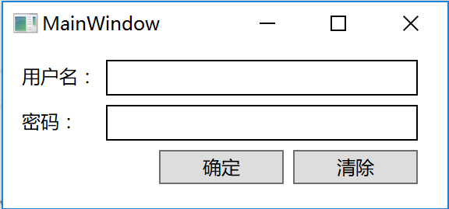
Layout布局
Canvas：用坐标对元素进行放置。
<Canvas>
<TextBlock Text="用户名：" Canvas.Left="12" Canvas.Top="12"/>
<TextBox Height="23" Width="200" BorderBrush="Black" Canvas.Left="66" Canvas.Top="9"/>
<TextBlock Text="密码：" Canvas.Left="12" Canvas.Top="41" Height="16" Width="36"/>
<TextBox Height="23" Width="200" BorderBrush="Black" Canvas.Left="66" Canvas.Top="38"/>
<Button Content="确定" Width="80" Height="22" Canvas.Left="100" Canvas.Top="67"/>
<Button Content="清除" Width="80" Height="22" Canvas.Left="186" Canvas.Top="67"/>
</Canvas>

Slide 25
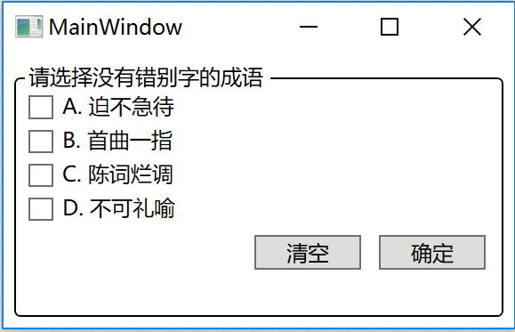
StackPanel：以堆叠的方式放置元素。
<GroupBox Header="请选择没有错别字的成语" BorderBrush="Black" Margin="5">
<StackPanel>
<CheckBox Content="A. 迫不急待" Margin="2"/>
<CheckBox Content="B. 首曲一指" Margin="2"/>
<CheckBox Content="C. 陈词烂调" Margin="2"/>
<CheckBox Content="D. 不可礼喻" Margin="2"/>
<StackPanel Orientation="Horizontal" HorizontalAlignment="Right">
<Button Content="清空" Width="60" Margin="5"/>
<Button Content="确定" Width="60" Margin="5"/>
</StackPanel>
</StackPanel>
</GroupBox>

Slide 26
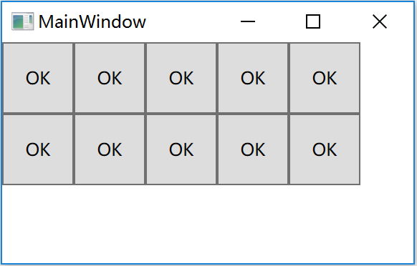
WrapPanel：以堆叠的方式放置子元素，自动在窗体边缘断行。
<WrapPanel Orientation="Horizontal">
<Button Width="50" Height="50" Content="OK"/>
<Button Width="50" Height="50" Content="OK"/>
<Button Width="50" Height="50" Content="OK"/>
<Button Width="50" Height="50" Content="OK"/>
<Button Width="50" Height="50" Content="OK"/>
<Button Width="50" Height="50" Content="OK"/>
<Button Width="50" Height="50" Content="OK"/>
<Button Width="50" Height="50" Content="OK"/>
<Button Width="50" Height="50" Content="OK"/>
<Button Width="50" Height="50" Content="OK"/>
</WrapPanel>

Slide 27
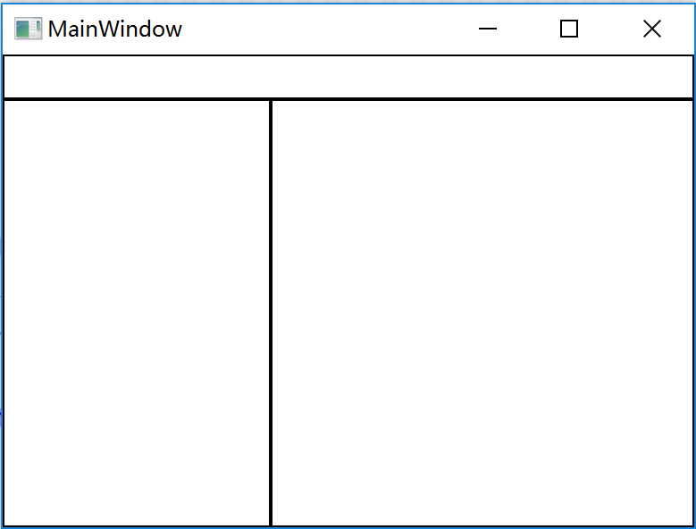
DockPanel：以船舶靠岸方式切分剩余可用空间。
<DockPanel>
<TextBox DockPanel.Dock="Top" Height="25" BorderBrush="Black"/>
<TextBox DockPanel.Dock="Left" Width="150" BorderBrush="Black"/>
<TextBox BorderBrush="Black"/>
</DockPanel>

Slide 28
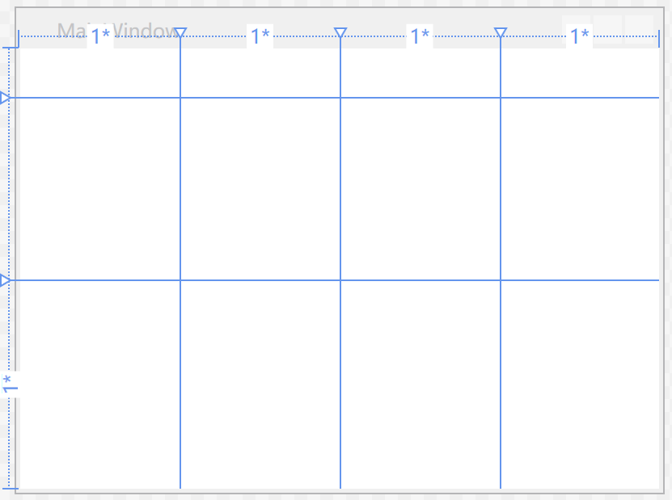
Grid：以网格形式放置元素。
<Grid>
<Grid.ColumnDefinitions>
<ColumnDefinition/>
<ColumnDefinition/>
<ColumnDefinition/>
<ColumnDefinition/>
</Grid.ColumnDefinitions>
<Grid.RowDefinitions>
<RowDefinition Height="30px"/>
<RowDefinition Height="3cm"/>
<RowDefinition />
</Grid.RowDefinitions>
</Grid>

Slide 29
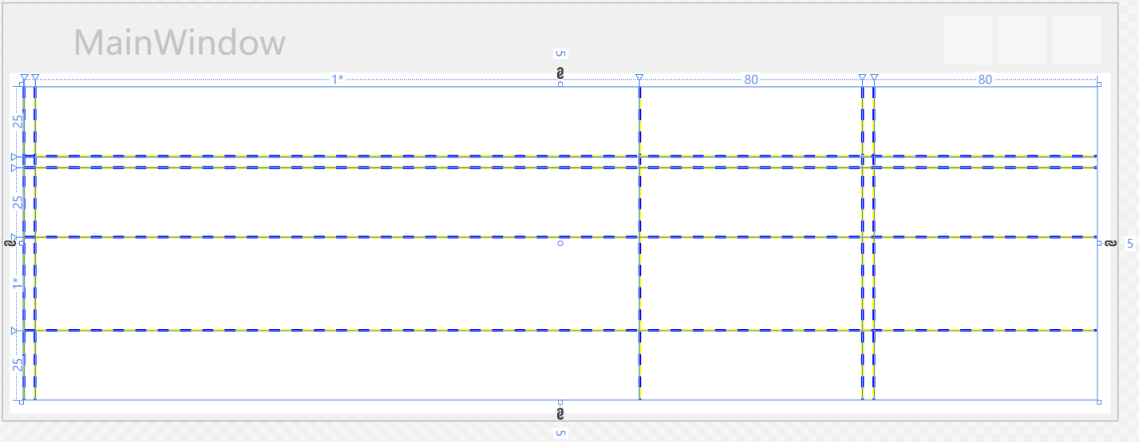
Grid行高和列宽单位
double数值
double数值*
Auto
<Grid Margin="5">
<Grid.RowDefinitions>
<RowDefinition Height="25px"/>
<RowDefinition Height="4px"/>
<RowDefinition Height="25px"/>
<RowDefinition Height="*"/>
<RowDefinition Height="25px"/>
</Grid.RowDefinitions>
<Grid.ColumnDefinitions>
<ColumnDefinition Width="Auto"/>
<ColumnDefinition Width="4px"/>
<ColumnDefinition Width="*" />
<ColumnDefinition Width="80px"/>
<ColumnDefinition Width="4px"/>
<ColumnDefinition Width="80px"/>
</Grid.ColumnDefinitions>
</Grid>

Slide 30
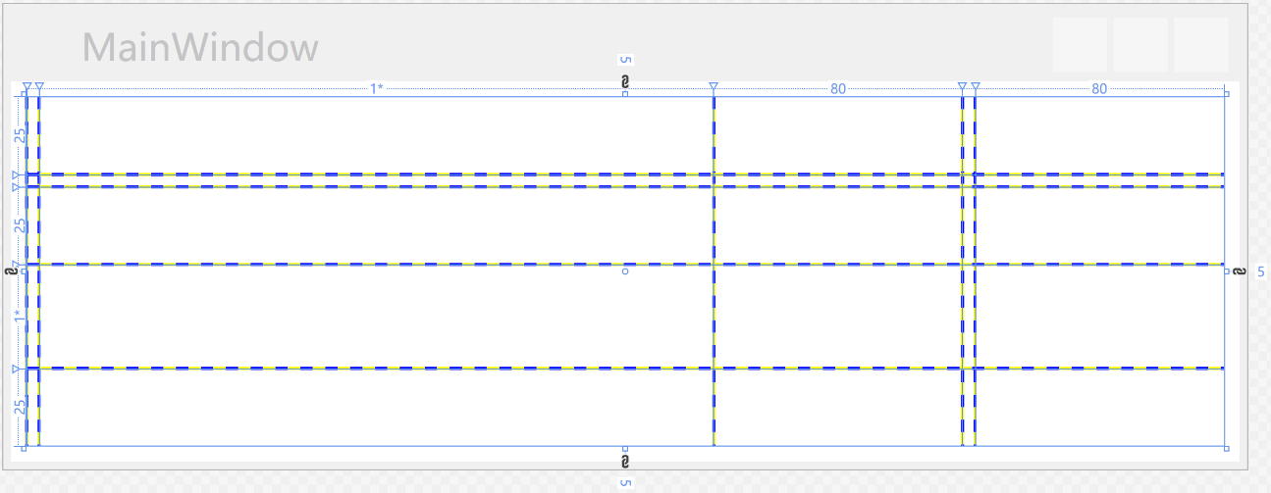
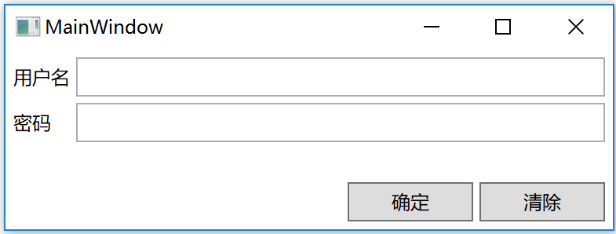
<TextBlock Text="用户名" Grid.Column="0" Grid.Row="0" VerticalAlignment="Center"/>
<TextBox Grid.Column="2" Grid.ColumnSpan="4" Grid.Row="0" />
<TextBlock Text="密码" Grid.Column="0" Grid.Row="2" VerticalAlignment="Center"/>
<TextBox Grid.Column="2" Grid.ColumnSpan="4" Grid.Row="2" />
<Button Content="确定" Grid.Column="3" Grid.Row="4"/>
<Button Content="清除" Grid.Column="5" Grid.Row="4"/>

Slide 31
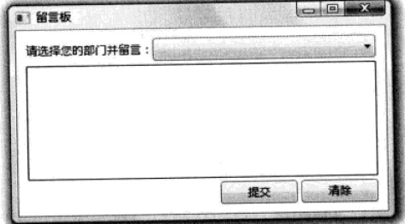

Slide 32
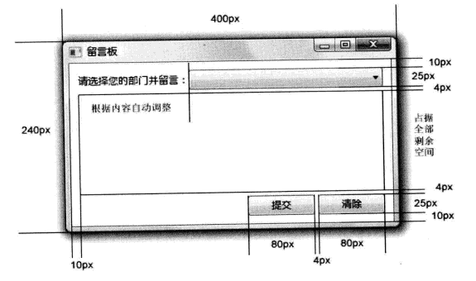

Slide 33
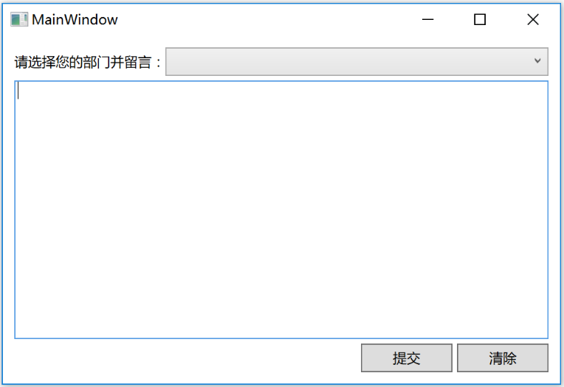
<Grid Margin="10" >
<Grid.RowDefinitions>
<RowDefinition Height="25"/>
<RowDefinition Height="4"/>
<RowDefinition Height="*"/>
<RowDefinition Height="4"/>
<RowDefinition Height="25"/>
</Grid.RowDefinitions>
<Grid.ColumnDefinitions>
<ColumnDefinition Width="Auto"/>
<ColumnDefinition Width="*"/>
<ColumnDefinition Width="80" />
<ColumnDefinition Width="4"/>
<ColumnDefinition Width="80"/>
</Grid.ColumnDefinitions>
<TextBlock Text="请选择您的部门并留言：" Grid.Column="0" Grid.Row="0" VerticalAlignment="Center"/>
<ComboBox Grid.Column="1" Grid.ColumnSpan="4" Grid.Row="0" />
<TextBox Grid.Column="0" Grid.ColumnSpan="5" Grid.Row="2" BorderBrush="Black"/>
<Button Content="提交" Grid.Column="2" Grid.Row="4"/>
<Button Content="清除" Grid.Column="4" Grid.Row="4"/>
</Grid>

